Slide 1

Chapter 1
Lexical Analyzer Generator-JLex
AMRITA VISHWA VIDYAPEETHAM School of Engineering,- Dept .of Computer Science & Engineering

Slide 2
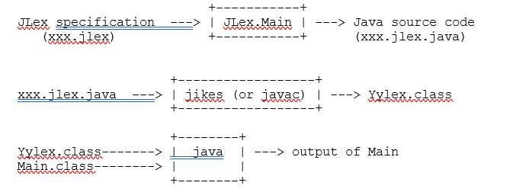
JLex
JLex is a scanner generator that produces Java code. Here's a picture illustrating how to create and run a program using JLex:
AMRITA VISHWA VIDYAPEETHAM School of Engineering,- Dept .of Computer Science & Engineering

Slide 3
The input to JLex is a specification that includes a set of regular expressions and associated actions.
The output of JLex is a Java source file that defines a class named Yylex.
Yylex includes a constructor that is called with one argument: the input stream (an InputStream or a Reader).
It also includes a method called next_token, which returns the next token in the input.
AMRITA VISHWA VIDYAPEETHAM School of Engineering,- Dept .of Computer Science & Engineering

Slide 4
Format of a JLex Specification
A JLex specification has three parts, separated by double percent signs:
User code:
JLex directives:
Regular expression rules:
AMRITA VISHWA VIDYAPEETHAM School of Engineering,- Dept .of Computer Science & Engineering

Slide 5
Structure of xxx.jlex
user code
%%
JLex directives
%%
regular expression rules

Slide 6
User code
User code precedes the first double-percent directive (``%%'). This code is copied verbatim into the lexical analyzer source file that JLex outputs, at the top of the file.
Therefore, if the lexer source file needs to begin with a package declaration or with the importation of an external class, the user code section should begin with the corresponding declaration.
This declaration will then be copied onto the top of the generated source file.
AMRITA VISHWA VIDYAPEETHAM School of Engineering,- Dept .of Computer Science & Engineering

Slide 7
JLex directives
This can include specifying the value that should be returned on end-of-file, specifying that line counting should be turned on, and specifying that the scanner will be used with the Java parser generator java cup.
The directives part also includes macro definitions.
The form of a macro definition is:
  name = regular-expression
where name is any valid Java identifier, and regular-expression is any regular expression as defined above.
AMRITA VISHWA VIDYAPEETHAM School of Engineering,- Dept .of Computer Science & Engineering

Slide 8
Here are some examples:
DIGIT= [0-9]
LETTER= [a-zA-Z]
WHITESPACE= [ \t\n]
Once a macro has been defined, it can be used in a regular expression (either to define another macro, or in the "Regular Expression Rules" part of the JLex specification
AMRITA VISHWA VIDYAPEETHAM School of Engineering,- Dept .of Computer Science & Engineering

Slide 9
Internal Code to Lexical Analyzer Class
The %{...%} directive allows the user to write Java code to be copied into the lexical analyzer class.
This directive is used as follows.
%{
<code>
%}
To be properly recognized, the %{ and %} should each be situated at the beginning of a line.
The specified Java code in <code> will be then copied into the lexical analyzer class created by JLex.
class Yylex {
... <code> ...
}
This permits the declaration of variables and functions internal to the generated lexical analyzer class.
Variable names beginning with yy should be avoided, as these are reserved for use by the generated lexical analyzer class.
AMRITA VISHWA VIDYAPEETHAM School of Engineering,- Dept .of Computer Science & Engineering

Slide 10
Initialization Code for Lexical Analyzer Class
The %init{ ... %init} directive allows the user to write Java code to be copied into the constructor for the lexical analyzer class.
%init{
<code>
%init}
The %init{ and %init} directives should be situated at the beginning of a line.
The specified Java code in <code> will be then copied into the lexical analyzer class constructor.
class Yylex {
Yylex () {
... <code> ...
}
}
This directive permits one-time initializations of the lexical analyzer class from inside its constructor.
Variable names beginning with yy should be avoided, as these are reserved for use by the generated lexical analyzer class.
AMRITA VISHWA VIDYAPEETHAM School of Engineering,- Dept .of Computer Science & Engineering

Slide 11
Exceptions
The code given in the %init{ ... %init} directive may potentially throw an exception, or propagate it from another function.
To declare this exception, use the %initthrow{ ... %initthrow} directive.
%initthrow{
<exception[1]>[, <exception[2]>, ...]
%initthrow}
The Java code specified here will be copied into the declaration of the lexical analyzer constructor.
Yylex ()
throws <exception[1]>[, <exception[2]>, ...]
{
... <code> ...
}
If the Java code given in the %init{ ... %init} directive throws an exception that is not declared, the resulting lexical analyzer source file may not compile successfully.
AMRITA VISHWA VIDYAPEETHAM School of Engineering,- Dept .of Computer Science & Engineering

Slide 12
End-of-File Code for Lexical Analyzer Class
The %eof{ ... %eof} directive allows the user to write Java code to be copied into the lexical analyzer class for execution after the end-of-file is reached.
%eof{
<code>
%eof}
The %eof{ and %eof} directives should be situated at the beginning of a line.
The specified Java code in <code> will be executed at most once, and immediately after the end-of-file is reached for the input file the lexical analyzer class is processing.
AMRITA VISHWA VIDYAPEETHAM School of Engineering,- Dept .of Computer Science & Engineering

Slide 13
Exceptions
The code given in the %eof{ ... %eof} directive may potentially throw an exception, or propagate it from another function.
To declare this exception, use the %eofthrow{ ... %eofthrow} directive.
%eofthrow{
<exception[1]>[, <exception[2]>, ...]
%eofthrow}
The Java code specified here will be copied into the declaration of the lexical analyzer function called to clean-up upon reaching end-of-file.
private void yy_do_eof ()
throws <exception[1]>[, <exception[2]>, ...]
{
... <code> ...
}
The Java code in <code> that makes up the body of this function will, in part, come from the code given in the %eof{ ... %eof} directive.
If this code throws an exception that is not declared using the %eofthrow{ ... %eofthrow} directive, the resulting lexer may not compile successfully.
AMRITA VISHWA VIDYAPEETHAM School of Engineering,- Dept .of Computer Science & Engineering

Slide 14
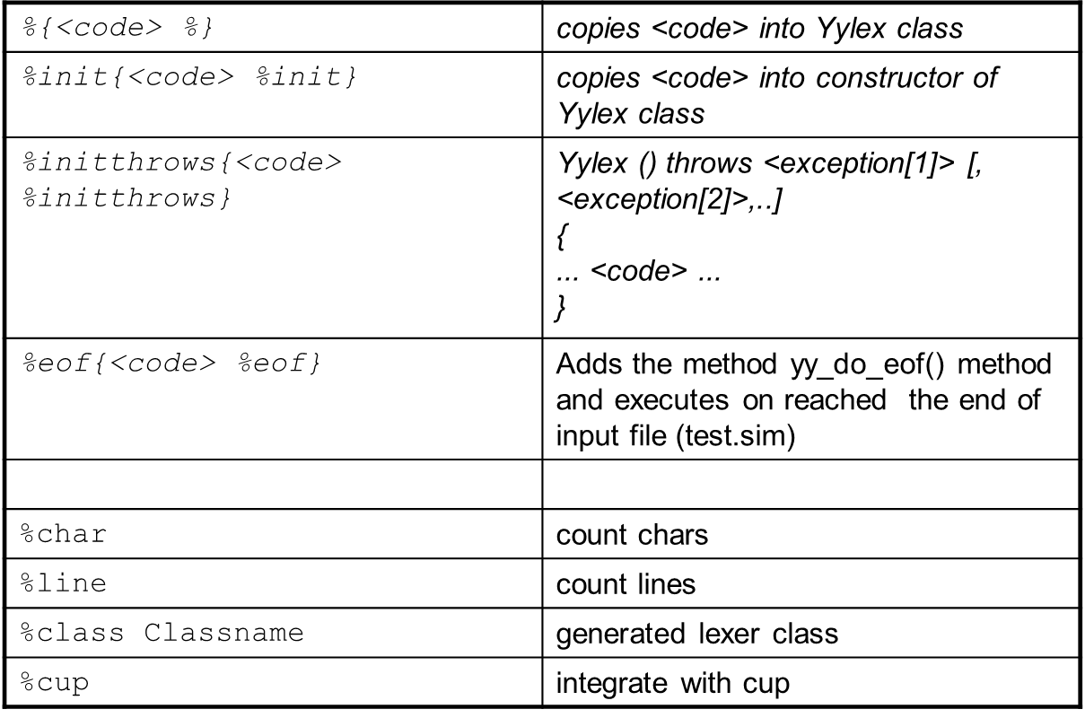
JLEX Directives
AMRITA VISHWA VIDYAPEETHAM School of Engineering,- Dept .of Computer Science & Engineering

Slide 15
Regular expression rules
A JLex rule:
  Regular Expression { action }
where action is Java code
  typically, the action returns a token
  but you want to skip whitespaces and comments
  Use a macro with curly braces eg: {digit}*
  yytext() returns the part of the input that matches the RE
  yyline, yychar can also be used to indicate zero-based index of line number and first character of the current token respectively.
AMRITA VISHWA VIDYAPEETHAM School of Engineering,- Dept .of Computer Science & Engineering

Slide 16
Matching the RE Rules
If several patterns that match the same sequence of characters, then the longest pattern is considered to be matched.
If several patterns that match the same (longest) sequence of characters, then the first such pattern is considered to be matched
  so the order of the patterns can be important!
If an input character is not matched in any pattern, the scanner throws an exception
  make sure that there can be no unmatched characters,(otherwise the scanner will "crash" on bad input).
AMRITA VISHWA VIDYAPEETHAM School of Engineering,- Dept .of Computer Science & Engineering

Slide 17
Regular expressions (where e and f are regular expressions):
  c any character c other than: ? * + | ( ) ^ $ . [ ] { } " \
  \c any character c, but \n is newline, \^c is control-c, etc
  . any character except \n
  “...” the concatenation of all the characters in the string
  ef concatenation
  e | f alternation
  e* Kleene closure
  e+ ee*
  e? optional e
  {name} macro expansion
  ^ matches beginning of line
  $ matches end of line
  [...] any character enclosed in [ ] (but only one character), from:
    c a character c (or use \c)
    ef any character from e or from f
    a-b any character from a to b
    “...” any character in the string
  [^...] any character except those enclosed by [ ]
AMRITA VISHWA VIDYAPEETHAM School of Engineering,- Dept .of Computer Science & Engineering

Slide 18
Example of RE rules
{LETTER}({LETTER}|{DIGIT}*)
{System.out.println(yyline+1 + ": ID " + yytext());}
{DIGIT}+ { return new Symbol(sym.INT,new Integer(yytext())); }
{DIGIT}+"."{DIGIT}+ { return new Symbol(sym.REALN,new Float(yytext())); }
"(" { return new Symbol(sym.LP); }
")" { return new Symbol(sym.RP); }
"," { return new Symbol(sym.COMMA); }
";" { return new Symbol(sym.SEMI); }
":=" { return new Symbol(sym.ASSIGN); }
"define" { return new Symbol(sym.DEFINE); }
"quit" { return new Symbol(sym.QUIT); }
"if" { return new Symbol(sym.IF); }
"then" { return new Symbol(sym.THEN); }
"else" { return new Symbol(sym.ELSE); }
"and" { return new Symbol(sym.AND); }
"or" { return new Symbol(sym.OR); }

Slide 19
RE rules with state
States and state transitions can be used for better control
  the initial (default) state is YYINITIAL
  any other state should be declared using the %state directive
  now a rule can take the form:
    <s> RE { action }
  which can match if we are in state s only
  you jump to a state s using
    yybegin(s)
AMRITA VISHWA VIDYAPEETHAM School of Engineering,- Dept .of Computer Science & Engineering

Slide 20
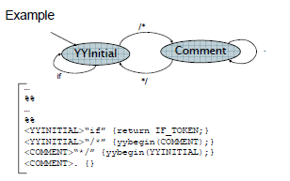
Example with states
AMRITA VISHWA VIDYAPEETHAM School of Engineering,- Dept .of Computer Science & Engineering

Slide 21
Sample Program
import java.io.*;
class Word{
String text;
Word(String t){
text=t;
}
}
class WordMain{
public static void main(String args[])throws IOException{
Yylex yl=new Yylex(System.in);
Word w=yl.yylex();
while(w.text!=null){
w=yl.yylex();
}
}
}
%%
letter=[a-zA-Z]
whitespace=[\t\n]
%type Word
%eofval{
return new Word(null);
%eofval}
%%
{letter}* { System.out.println("word = "+yytext());}
{whitespace} { /* skip */}
AMRITA VISHWA VIDYAPEETHAM School of Engineering,- Dept .of Computer Science & Engineering

